Slide 1
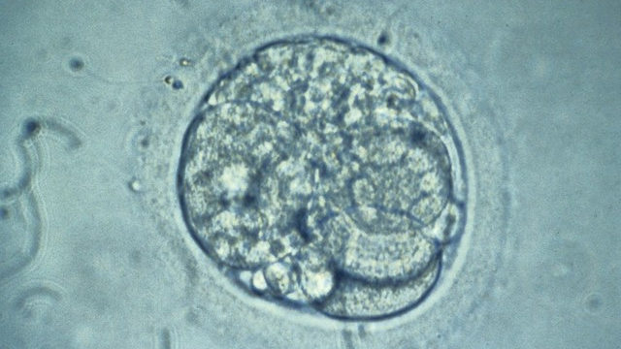
IVF Alabama Act 2024-20
What underlying action led to Supreme Court decision?
What did the Supreme Court opinion really say?
What does the Act do?
This Photo by Unknown Author is licensed under CC BY

Slide 2
IVF – Underlying action
An unauthorized individual accessed a cryopreservation tank containing frozen embryos in an IVF clinic and removed some of the embryos
Three affected families sued the IVF clinic and the adjoining hospital where the unauthorized individual entered the IVF clinic, claiming the defendants were responsible for the “wrongful death” of the embryos
The defendants filed motions to dismiss each of the actions, claiming that a frozen embryo should not be considered a “minor child” for purposes of the Alabama Wrongful Death of a Minor Act
The trial court granted the motions, dismissing the actions
The plaintiffs appealed the trial court’s order dismissing the actions, claiming that “minor child” is not defined under the Alabama Wrongful Death of a Minor Act, and therefore, a frozen embryo could be considered a minor child for purposes of the Act
The Supreme Court’s opinion overruled the trial court’s granting of the defendants Motions to Dismiss, and the legislature’s statutory fix from the 2024 Regular Session has no bearing on the underlying case, so it is still pending

Slide 3
IVF – Supreme Court opinion
The Supreme Court reversed the trial court’s order dismissing all the actions, holding that the term “minor child” under the Alabama Wrongful Death of a Minor Act includes any unborn child, regardless of stage of development and regardless of location
Summary of points that led to conclusion
The legislature elected NOT to define “minor child” when the Wrongful Death of a Minor Act was passed (in 1876)
Older court interpretations of the term “minor child” included unborn children only if they were considered viable, but more recent opinions extended the definition of “minor child” to include unborn children at any stage of development
Criminal statutes in Alabama, including those related to homicide and also those that prohibit abortion, define a “person” and an “unborn child,” respectively, to include the unborn in utero at any stage of development, but despite the defense arguments that civil remedies should be consistent with criminal ones, the Supreme Court sided with the plaintiffs, concluding it was more important for there to be a civil remedy in every instance where a criminal remedy was available than for those to be consistent
The Court opined that the inconsistency issue was the Legislature’s problem to fix

Slide 4
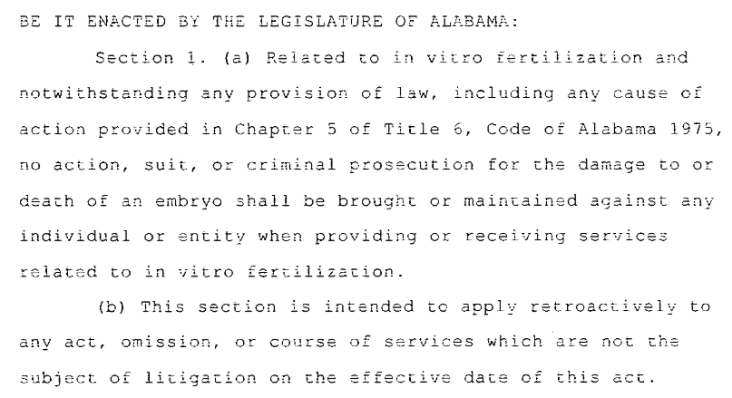
IVF – Legislative Act 2024-20
From SB159
Section 1 protects the physicians, staff and practices who perform IVF from criminal actions or prosecutions
It is to be applied retroactively, except for any action already pending, i.e., the underlying action.
Why? Alabama Constitution, Section 95, in part:
“After suit has been commenced on any cause of action, the legislature shall have no power to take away such cause of action, or destroy any existing defense to such suit.”

Slide 5
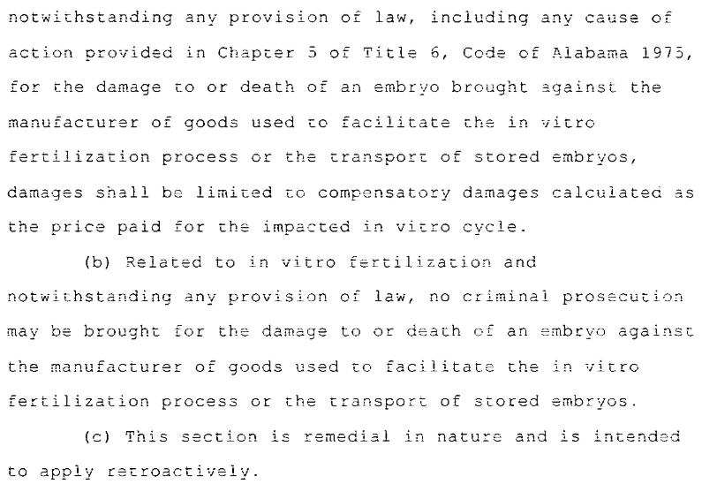
IVF – Legislative Act 2024-20
From SB159
Section 2 protects manufacturers of products used to facilitate IVF and transporters of stored embryos.
It prohibits criminal prosecution and limits damages in civil action to the cost of the impacted IVF cycle.
It is to be applied retroactively, with no underlying action currently pending.

Slide 6
IVF – Legislative Act 2024-20
Is it enough?
It allows IVF clinics to continue to practice in Alabama…for now…without fear of prosecution or costly damage awards
It also protects manufacturers of goods used in the IVF process and transporters of frozen embryos
But…
It does not address the Supreme Court’s implied definition of when life begins
It is vulnerable to constitutional challenges because of the blanket immunity provisions
Of note – Supreme Court has denied an application for rehearing since Act 2024-20 was passed
All of the families involved in the underlying action except for one have agreed to a settlement

